Slide 1
Restoration of five semi-leather bindings of books of the 19th century from the collection of the D.I. Mendeleev St. Petersburg State University
Final qualifying work
4th year student
Isilyaev Igor Vladimirovich
Scientific adviser:
Associate Professor, PhD in Art History
Torbik Vladimir Sergeevich
Saint Petersburg 2023

Slide 2
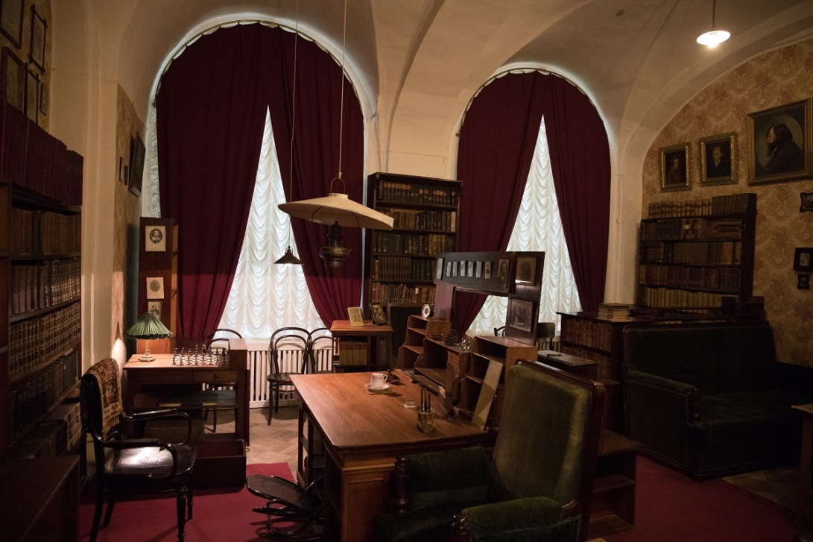
Историческая справка
Museum-archive of D.I. Mendeleev St. Petersburg State University
Museum-archive of the great
Russian scientist
Dmitri Ivanovich Mendeleev
located in the main building
twelve colleges
St. Petersburg
state university.

Slide 3
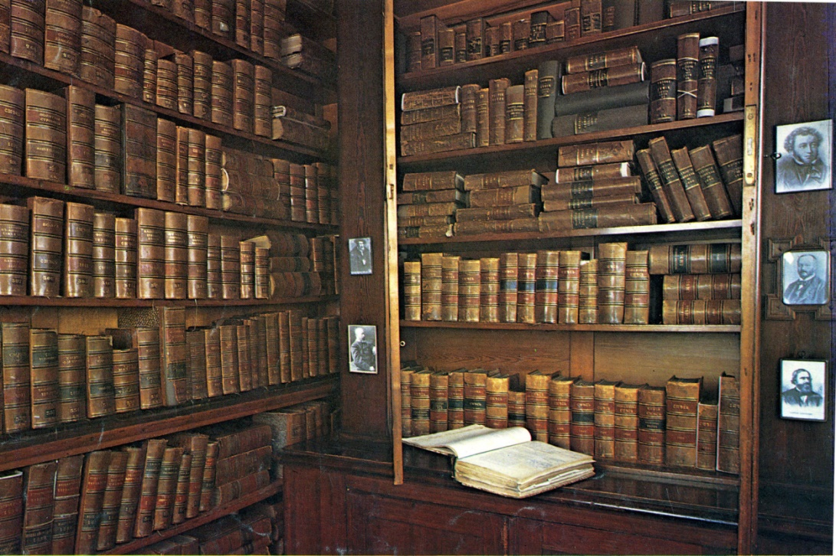
Историческая справка
Museum-archive of D.I. Mendeleev St. Petersburg State University
In the office
collected an extensive library.
The bulk of the books
received in the 80-90s of the 19th century.
At present, the total number of books, brochures and individual prints reaches
16,000 units.

Slide 4
The result of the inspection of the condition of the bindings
Damage form
2% Old restoration
40% Deformation of the book binding
100%!!! Increased acidity of paper Drip method (LKRDrN-meter-340) pH=6.1
10% sewing damage
20% Damage to notebooks
25% Cover Damage
30% Destruction of the spine, separation from the binding

Slide 5
State of the binding before restoration
Convolute:
Баконъ, Баконъ. Собранiе сочинiй
1874, 316 Д.М.
Date of execution:
end of the 19th century. 1874
Inventory number: ММ ВХ ЭФЗК 2607
1. the sewing cords are torn

Slide 6
State of the binding before restoration
Convolute:
G.Herrm.Oelsner. Доливо-Добровольская
В.А., Забудский Н. 1892 Технологiя Баллистика Удобрения 333 Д.И,
Date of execution:
end of the 19th century. 1890-1892
Inventory number: ММ ВХ ЭФЗК 1665
2. the leather spine is torn off

Slide 7
State of the binding before restoration
Convolute:
Алексеев В.,Забудский А.,Frenkel M. Алексеевъ, Калкутскиiй, Петрушевский и др. 1890. 241 Д.М.
Date of execution:
end of the 19th century. 1886-1890
Inventory number: ММ ВХ ЭФЗК 2454
3.Deformed cardboard cover

Slide 8
State of the binding before restoration
Convolute:
Winkler C., Efimov A.I., Kapustin S.Ya., Aristov N. Mixture.. 1890. 243 D.M.
Execution date:
end of the 19th century, 1866-1890
Stock No.: MM VX EFZK 2487
4.
Damage: Notebooks fall out of the book block.

Slide 9
State of the binding before restoration
Book:
Gerard, Chancel, Mendeleev D.I. 1007.
Analytical Chemistry of Gerard and Chancel. Qualitative analysis.
383 D.M.
Execution date:
Late 19th century, 1864
Stock No.: MM VX EFZK 1071
5.
Damage: according to the initial visual examination, there is no original marbled paper.

Slide 10
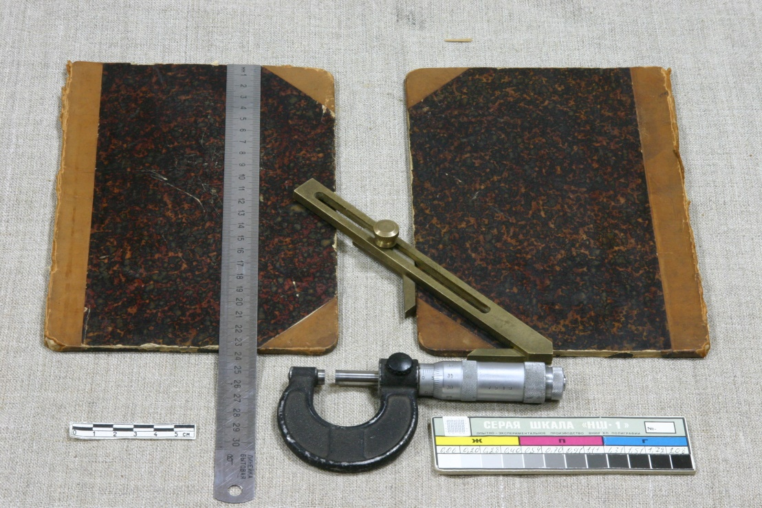
Restoration process
Cardboard lids. Marble
Disassembly of the binding: the covers are separated, the exact dimensions of the cardboard covers and corners are removed.

Slide 11
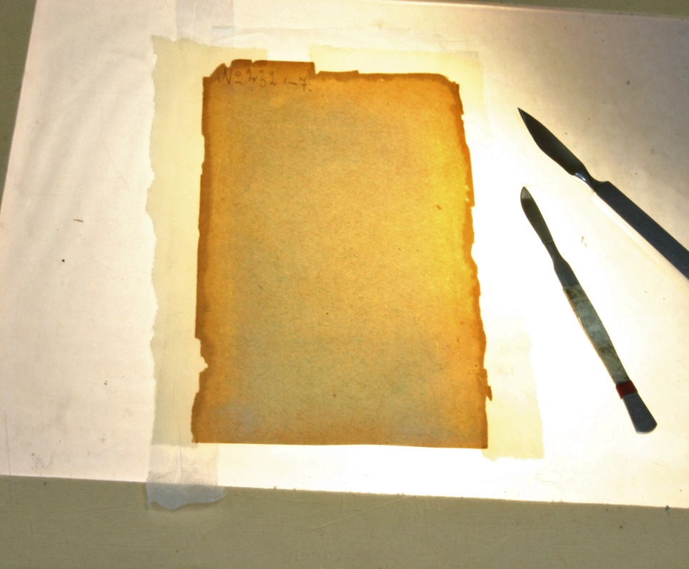
Restoration process
Marble. Bookends.
Soaking in a ditch. Department of marble and endpapers. Transfer for restoration.

Slide 12
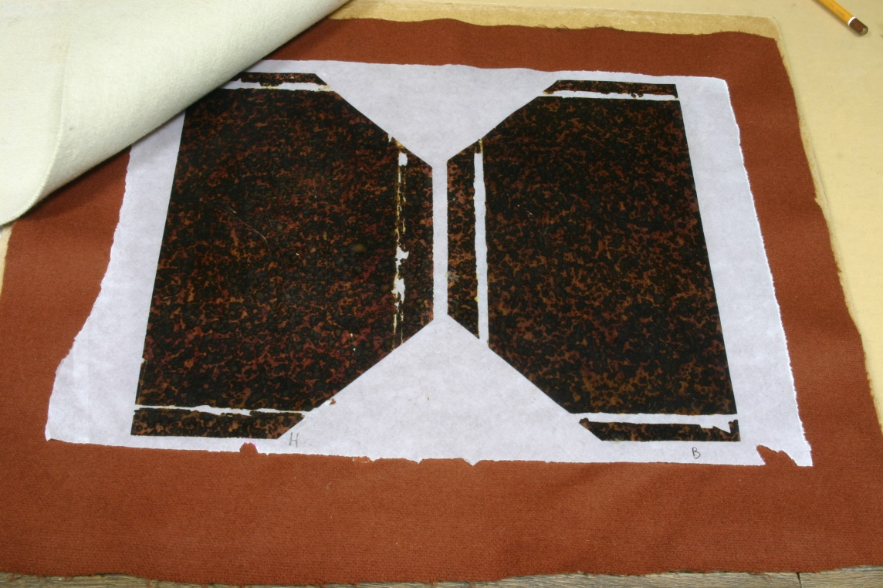
Restoration process
Marble.
Pressing the marble paper between the cloth until completely dry.

Slide 13
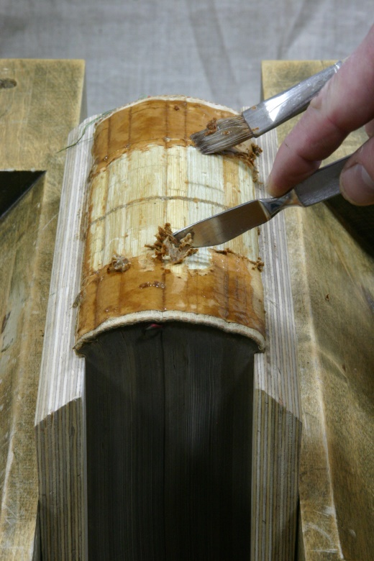
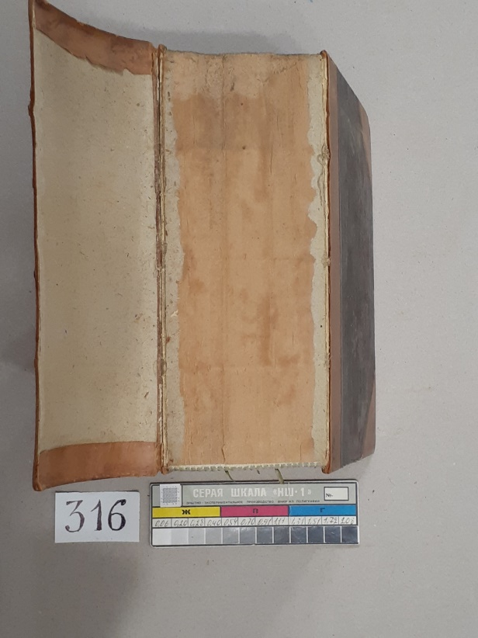
Restoration process
Book block
Deformed block. The formation of the spine in a vise. Removing adhesive residue.

Slide 14
Restoration process
Restoration process
On the book block
are recovering
sewing cords
Materials: natural linen thread, needle.

Slide 15
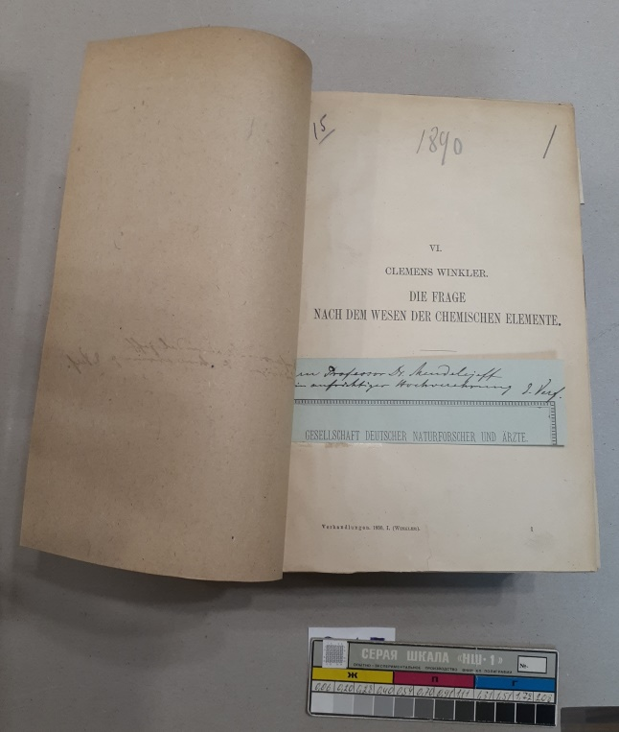
Restoration process
Restoration and filing of the first notebooks
Before restoration After restoration and filing to the block

Slide 16
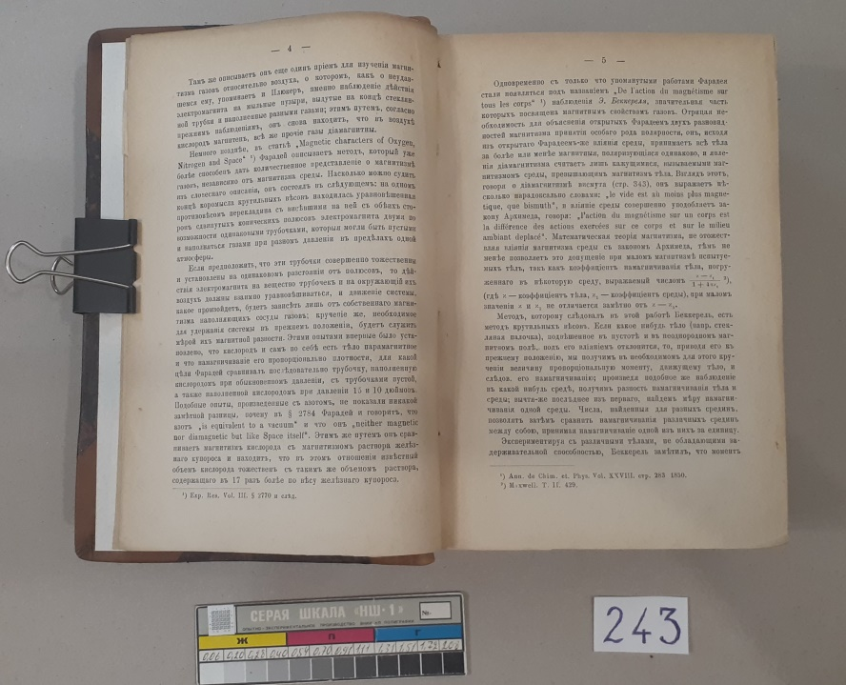
Restoration process
Filing of notebooks of the book block.
Destruction of sewing before restoration Restoration of sewing after restoration

Slide 17
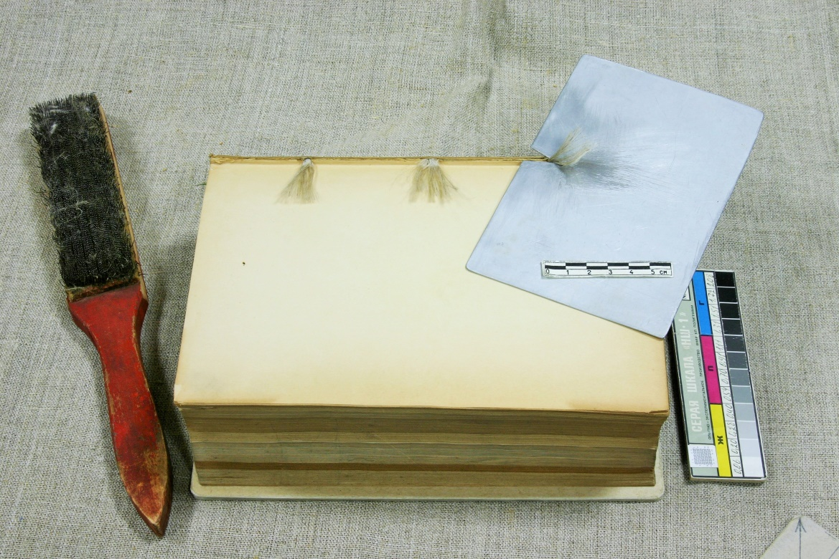
Restoration process
Book block. The final stage: the formation of the "mushroom cap"
Manufacturing and
gluing
paper sleeve
book block
clamped down to
complete drying
Combing yarn cords sewing into fibers

Slide 18
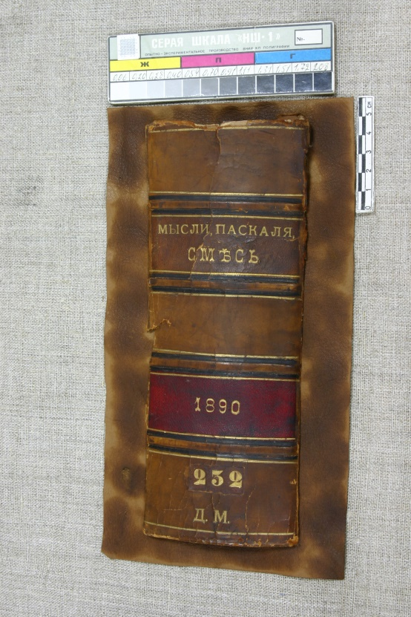
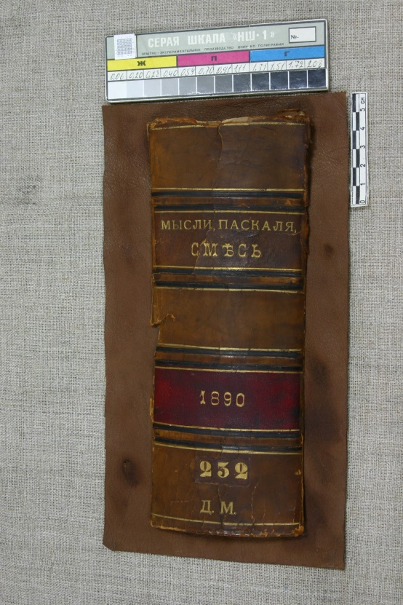
Restoration process
Toning the new leather base
Vegetable tanned calfskin leather. Material: aniline dye.

Slide 19
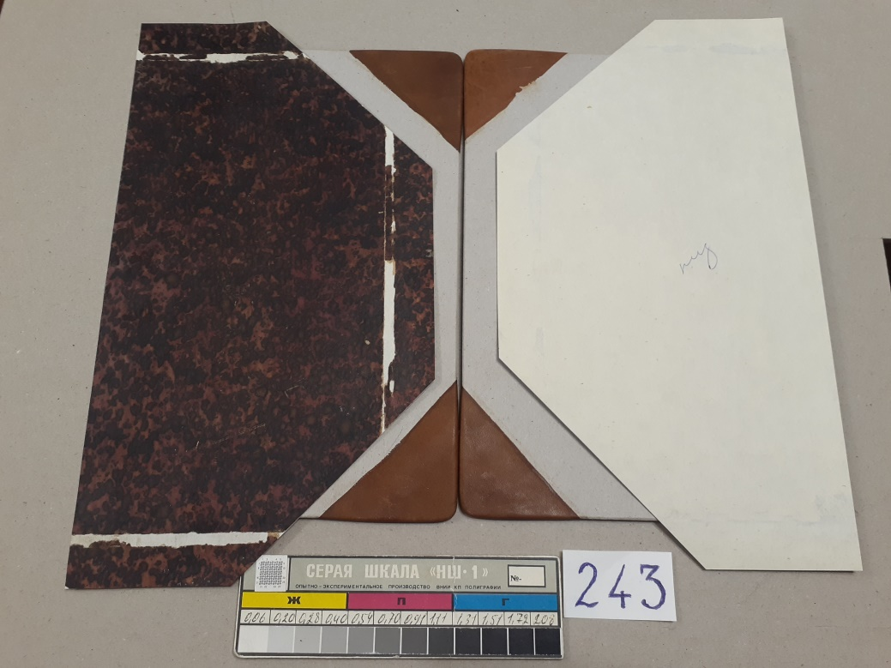
Restoration process
Production of new cardboard covers Production of leather corners

Slide 20
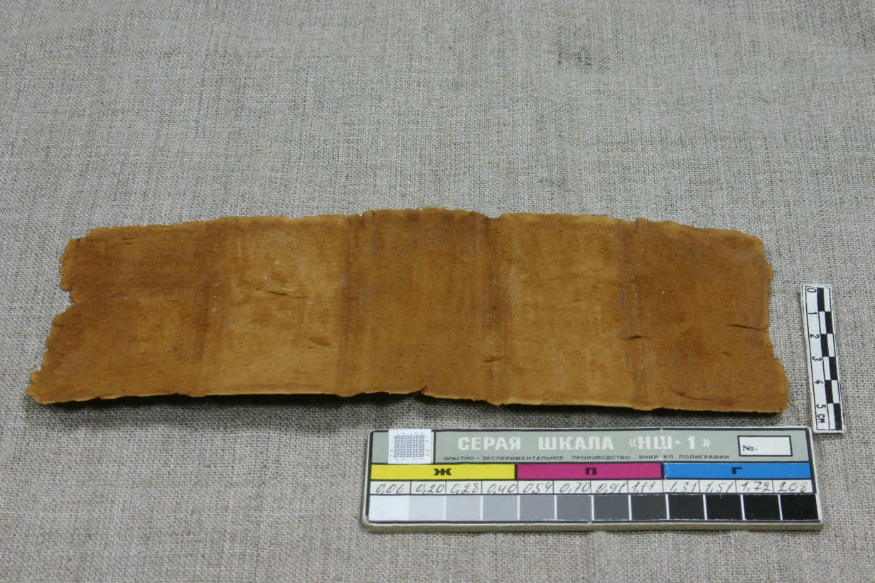
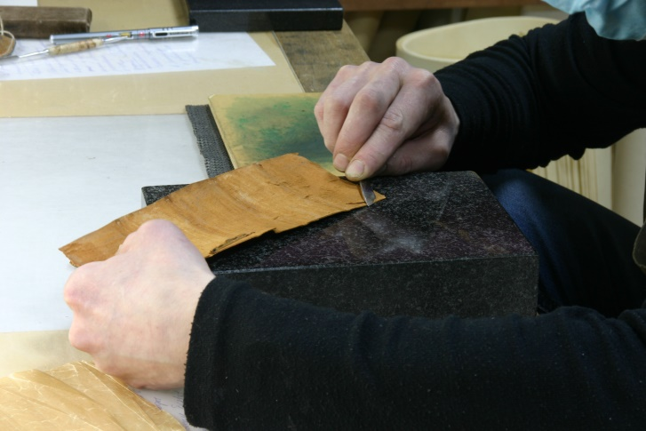
Restoration process
Cleaning a fragment of the old spine from traces of paper lag and glue

Slide 21
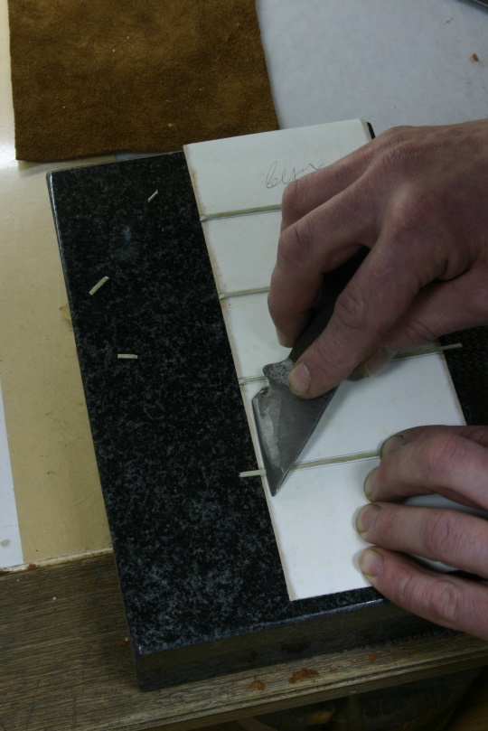
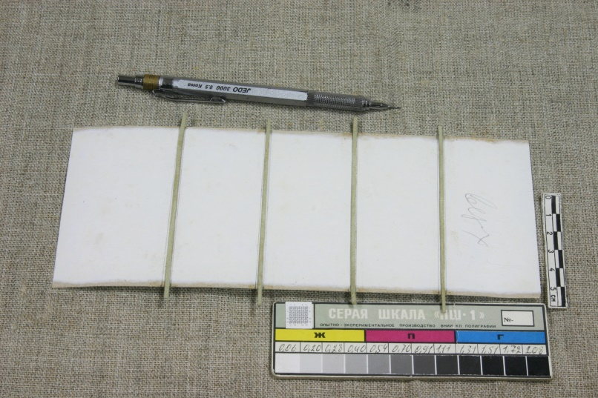
Restoration process
Imitation of "false" sewing bandages on a new lagging
Marking bandages on a new lag Gluing leather strips - Oblique cut edges
binding bandages

Slide 22
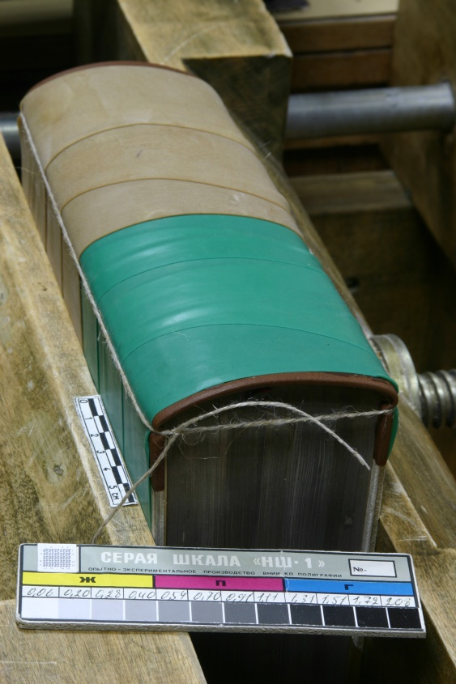
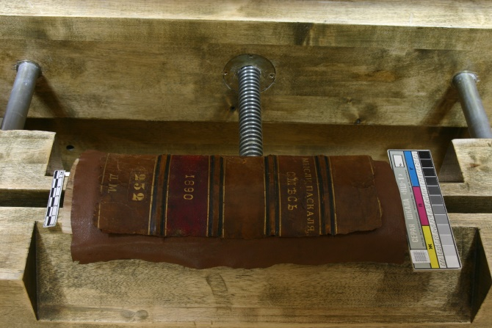
Restoration process
Spine recovery
The new leather base is lagged glued.
We select "false" bandages
2. We fix the adhesive with elastic
rubber bandages.
We make a binding through
end hinges of covers.
select "ears"
3. Glue the old spine
on a new leather base.

Slide 23
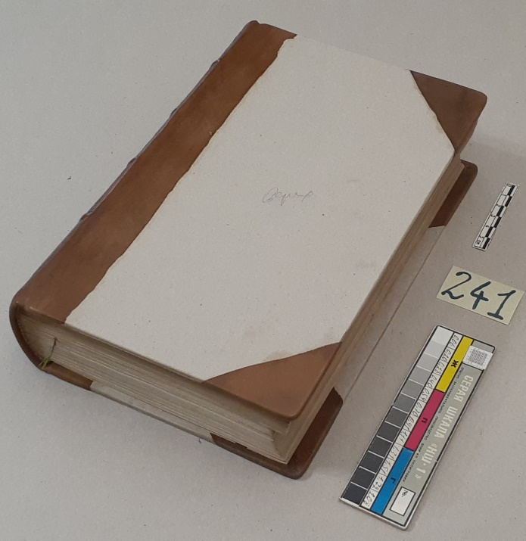
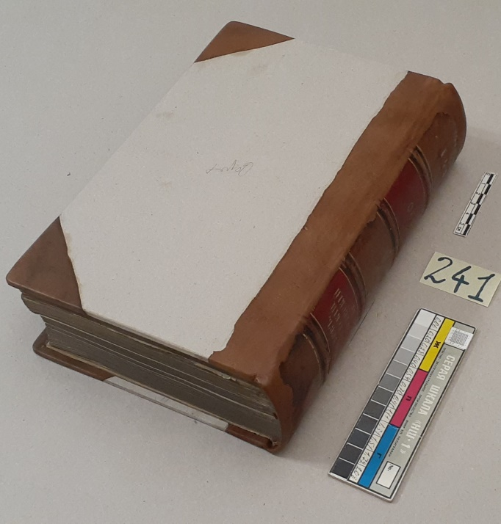
Restoration process
Binding assembly
New corners New spine Old fragment on a new basis

Slide 24
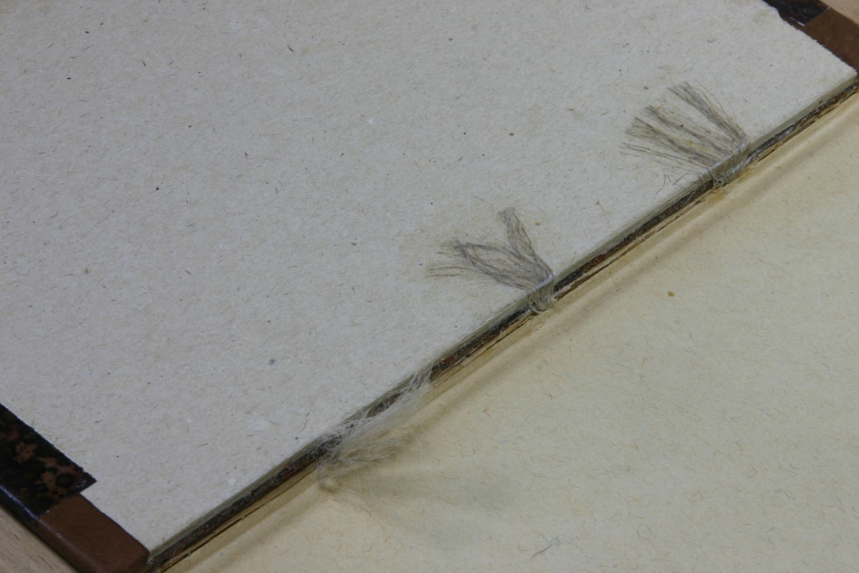
Restoration process
Marble paper and cords
1. Bonding of the marbled paper 2. Cords glued on the inside to the lids

Slide 25
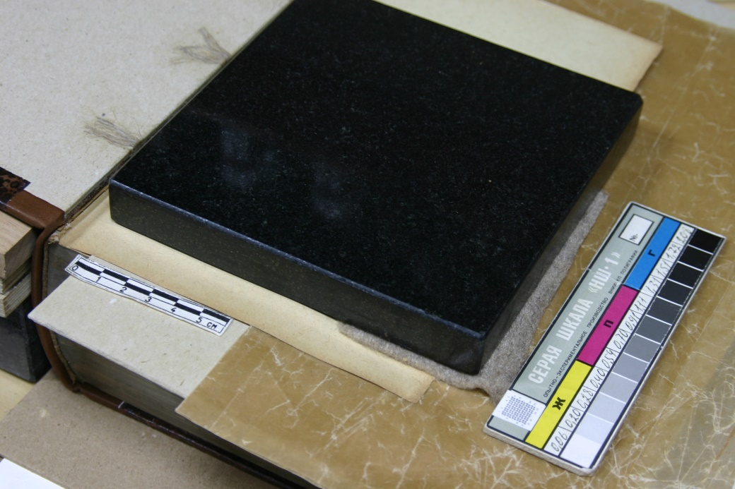
Restoration process
Strengthening gaps on endpapers.
Materials: flour glue, cloth, Japanese paper, small weight.

Slide 26
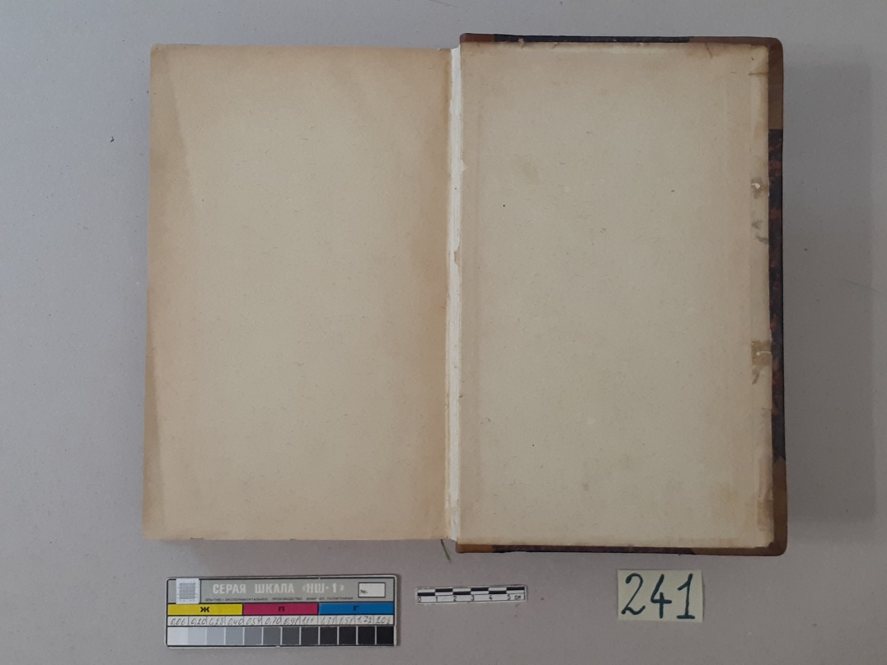
Restoration process
Pasting bookends
Upper binding cover Lower binding cover

Slide 27
Restoration process
Marble tinting
paper on the ends of the lids
Reinforcing the front
marble paper (PVButyral
5% alcohol solution)
Processing of leather elements
lanolin-based impregnation
and wax

Slide 28
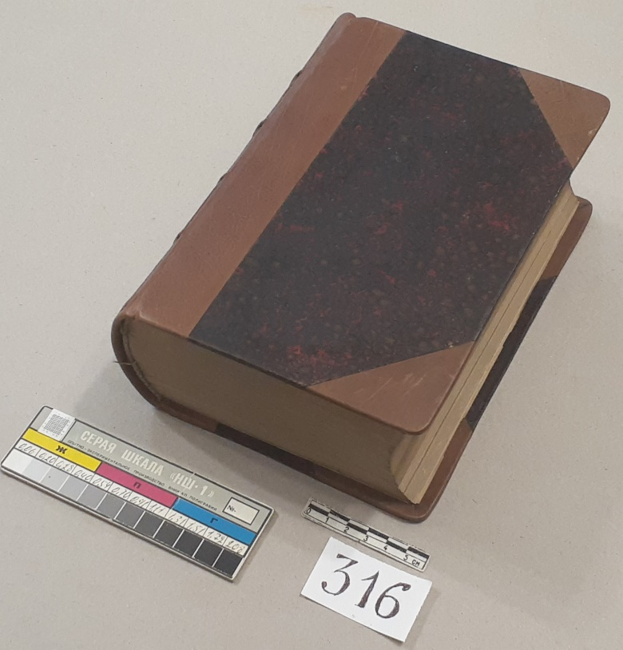
The result of restoration activities
D.M. 316
1.Repaired sewing cords;
2. Notebooks are filed,
formed, fortified
book block;
3. Made new carton
Covers;
4. New corners were made and
a new spine for the old base;
5.Reinforced marble paper.
Before restoration After restoration

Slide 29
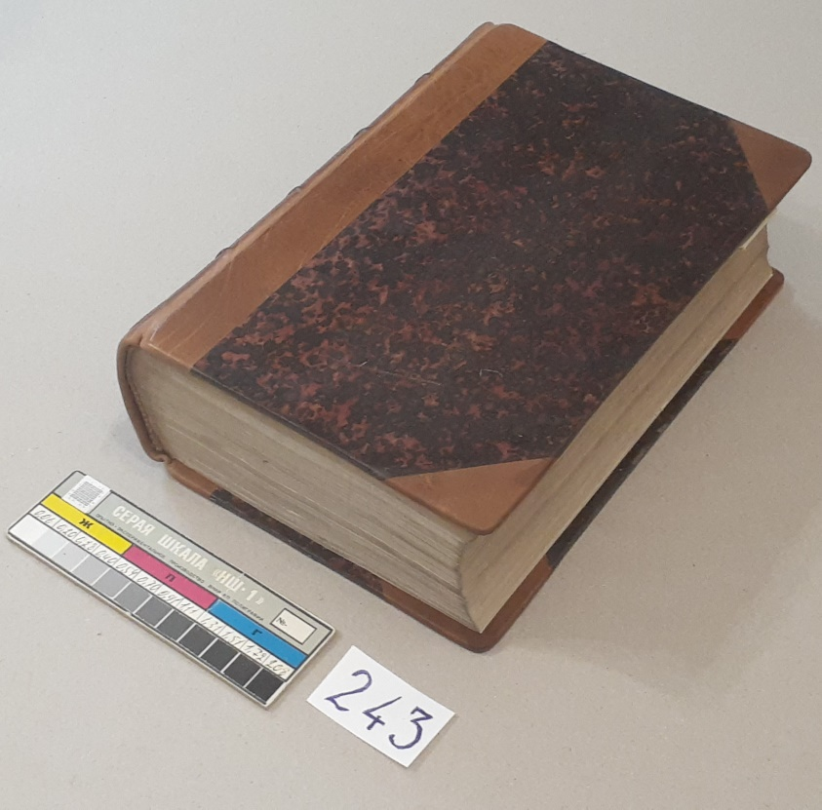
The result of restoration activities
D.M. 243
1.Repaired sewing cords;
2. Notebooks are filed,
formed, fortified
book block;
3. Made new
cardboard covers;
4. Made new corners and a new spine
for the old base;
5.Refurbished
marble paper.
Before restoration After restoration

Slide 30
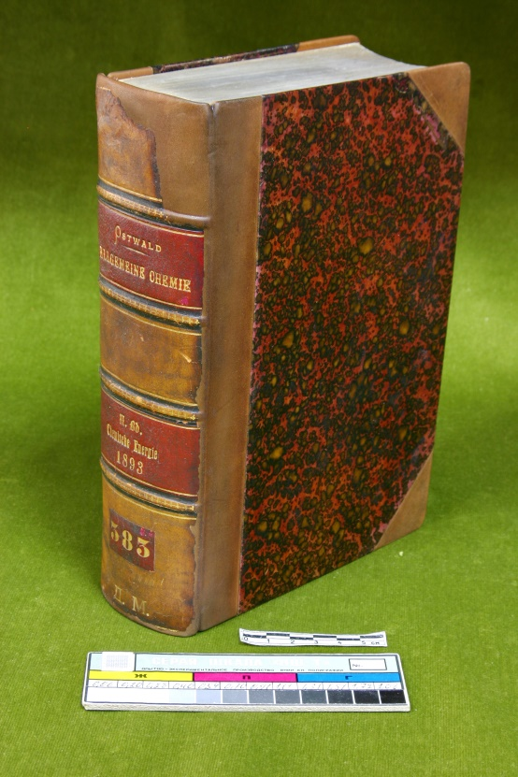
The result of restoration activities
D.M. 383
1.Repaired sewing cords;
2. Notebooks are filed,
formed, fortified
book block;
3. Made new carton
Covers;
4. New corners were made and
a new spine for the old base;
5. Restored marble paper.
Before restoration After restoration

Slide 31
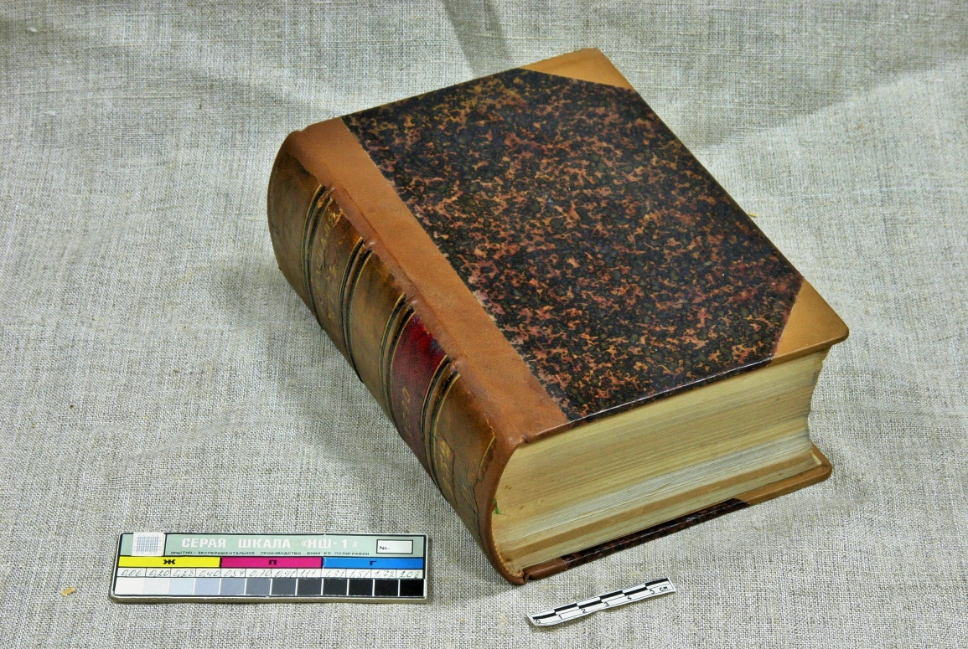
The result of restoration activities
D.M. 333 Before restoration After restoration

Slide 32
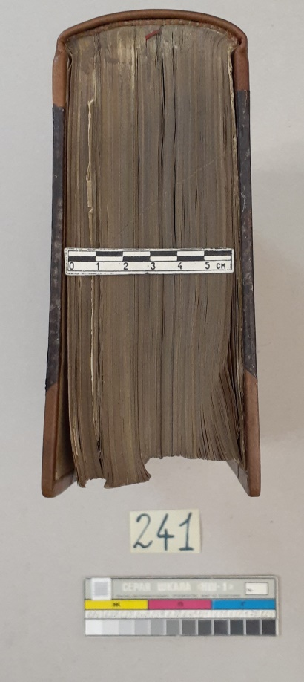
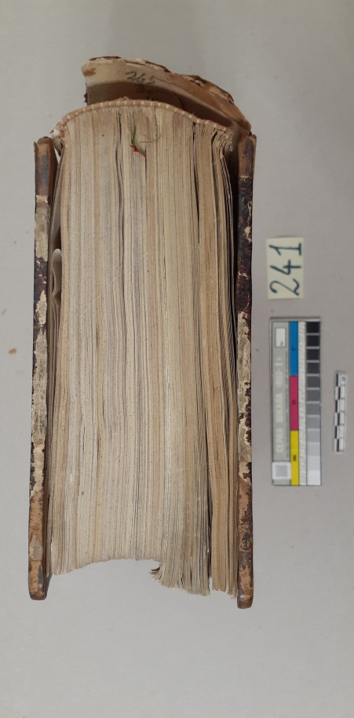
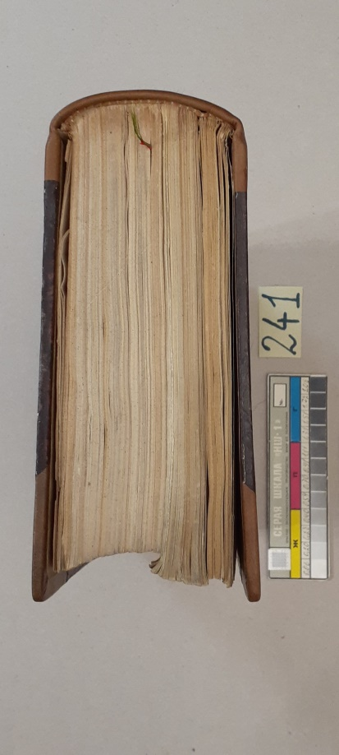
The result of restoration activities
D.M. 241 Before and after restoration ("head") Before and after restoration ("tail")

Slide 33
Conclusion
In the restoration of semi-leather bindings from the collection of the D.I. Mendeleev
an alternative technique was used to restore the basic functions of the binding
accepted in many restoration centers, laboratories and libraries in Russia.
Reversible adhesives were used: flour and animal origin, neutral cardboard,
vegetable tanned calfskin, linen, aniline dyes.
The binding has gained strength and high performance characteristics.
All this makes it possible to use bindings in the museum exposition and
in scientific works.
Photo: 1.2; https://spbu.ru/news-events/krupnym-planom/muzey-arhiv-d-i-mendeleeva-spbgu-svyaz-vremen

